Slide 1
Twofold nature of Social Capital: Opportunities and difficulties for Interdisciplinary research
Dr. Ilona Baumane-Vitolina
This research was possible due to Marie Curie programme, IRSES scheme PIRSES-GA-2012-318961

Slide 2
CV Ilona Baumane-Vītoliņa
2000-2004 University of Latvia, Bachelor degree in Social Sciences
2004-2005 University of Rostock, Germany, MBA (Master of Business administration and law)
2005-.... Docent, University of Latvia, Faculty of Economics and Management
2008-2012 Assignment manager Amrop (headhunting)
2005 - 2011 University of Latvia, PhD in entrepreneurship
Taught subjects: history of economics, international economics, organizational behavior, theory of organization.

Slide 3
Some publications and research fields
„Vergleich der Geschäftskulturen in Lettland und Deutschland. Aspekte der Zusammenarbeit“ in Müller S., Management Guide LETTLAND, Cross-Culture Publishing Frankfurt/Main., 2006, 125.-137. lpp.
“Social Capital as an important factor for synergy creation in organizations” (līdzautors: Dr. oec., profesore Ērika Šumilo) in Turk, K., Vadi, M., Aidla, A.:Management Theory and Practice: Synergy in Organizations, Tartu University Press, 2007, 70.-83. lpp.
“Trends and priorities in the development of the Latvian banking services in the context of emerging knowledge-based economy: case of e-banking” (līdzautori: Valters Kaže, Dr. oec., profesore Ērika Šumilo, Dr. oec., profesors Roberts Škapars) in TRAMES, Journal of the Humanities and Social Scieneces, Special issue „Dynamics around and within organizations”, Vol. 11, No. 2, 2007, lpp. 173-189.
“The construction of national identity among minorities and its manifestations in organizations: the case of Latvia” (co-author: Dr. Rebeka Vedina) Baltic Journal of Management, 4(1), 2009., pp. 94-105.
“Capacities and competencies as sources of competitive advantage: The case study of Latvian Hotels” (co-author: Dr. Rebeka Vedina) Review of International Comparative Management, 12(2), 2011, pp.301-318.
“Innovation capabilities in tourism and food production SMEs in the Baltic Sea Region” (co-authors: Per Lind, Tatjana Simonova, Aivars Timofejevs, Rebekka Vedina, Piotr Wrobel) International Journal of Knowledge Management Studies, Vol. 4, No. 4, 2011, pp. 336-358.
“Innovation capabilities in small catching-up economies: Evidence from food manufacturing and tourism sector” (co-author: Dr. Rebeka Vedina), in Carayannis, G., Varblane, U. and Roolaht, T. (Eds.): Innovation Systems in Small Catching-Up Economies, Springer Publishing, New York, NY, 2012, pp. 215-234.
PIRSES-GA-2012-318961

Slide 4
What is Social Capital and why is it important nowadays?
PIRSES-GA-2012-318961

Slide 5
Some problems defining social capital:
Public or private good?
PIRSES-GA-2012-318961

Slide 6
Examples of Social capital definitions as a private good:
Ability of persons to gain benefits from specific social structures, in which they are involved based on trust, social norms and values (Portes, 1998)
According to Burt (1992) social capital refers to opportunities for unfolding your financial and human capital using your personal contacts
PIRSES-GA-2012-318961

Slide 7
Examples of Social capital definition as public good:
According to Fukuyama (1995), social capital refers to ability of people to work together in groups towards achieving common organizational goals (spontaneous sociability)
Putnam (1993) argues that social capital refers to such features of organizations as trust, norms and networks enabling facilitation of economic transactions.
PIRSES-GA-2012-318961

Slide 8
Examples of Social capital definitions as both private and public good:
“ Social capital is the sum of the resources, actual or virtual, that accrue to an individual or a group by virtue of possessing a durable network of more or less institutionalized relationships of mutual acquaintance and recognition” , (Bourdieu, in Bourdieu & Wacquant, 1992: 119)
“the sum of the actual and potential resources embedded within, available through, and derived from the network of relationships possessed by an individual or social unit. Social capital thus comprises both the network and the assets that may be mobilized through that network”, (Nahapiet, Ghoshal, 1998: 243)

Slide 9
Dimensions of Social capital:
Structural (networks)
Relational (trust)
Cognitive (shared vision, norms and values)

Slide 10
Forms of trust:
Generalized trust
Personalized trust

Slide 11
What are the main dividends one gets from social capital?

Slide 13
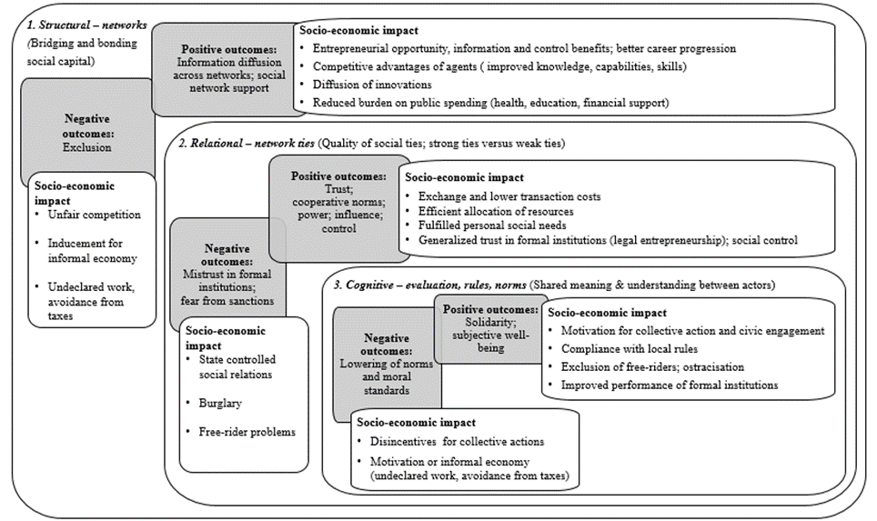

Slide 14
Misconceptions about Trust
http://www.youtube.com/watch?v=1PNX6M_dVsk

Slide 15
Social network theories:
Various instruments and levels of analysis

Slide 16
http://www.youtube.com/watch?v=2U-tOghblfE&feature=player_embedded

Slide 17
Development of social network analysis
Research of triades (Simmel (1955 trans.))
Sociometrics (Moreno (1953))
Rapid development of network analysis methodology in 70ies and 80ies (UCINET)

Slide 18
Network types, characteristics and measurement opportunities
Network is a system of ties between nodes
Ties are often more important predictor of behaviour then characteristics of nodes (demographic or psychological)
“Sometimes it is more important who you know than what you know.”
Important are not only the direct relationships (ties) between nodes, but also the position within the network
Networks can be researched at all levels of analysis

Slide 19
Examples of nodes and ties
People tied by friendship or acquintainship
Conversational network (who talkes to whom in the group)
Film actors tied by acting in the same film
Florentine family intermarriage network (Padgett & Ansell, 1992)
Boards of directors sharing members
Internet pages are nodes connected by hot links that direct browsers to and from each other

Slide 20
Levels of analysis for network research
Ego network – all of a node’s direct contacts
Overall network – all actors and relationships within a particular domain
Network position – actor’s coordinates within a given network

Slide 21
Basic network measures:
Distance – the length of the shortest path btw. 2 actors. (degrees of separation)
Closeness - average degrees of separation
Centrality – importance of an actor within the system.
- Degree – how many contacts one has
In-degree
Out-degree
- Betweenness – how often a nod is a shortest path btw. any 2 other nods in the network?
- Eigenvector – do I have many friends who themselves have many friends?

Slide 22
Basic network measures:
Clustering and structural holes
Clustering – are your friends also friends with each other?
Structural holes – brokerage principle (Burt, 1992)
Structural equivalence
Density - % of possible relations in a network that are actually observed (density decreases with size)
Centralization – extent to which some actors in a system are well connected and others are not.

Slide 23
Types of network organizations (Miles & Snow, 1992)
Stable network (Nike)
Dynamic network (fashion production, Hollywood)
Internal network (Accenture, ABB)

Slide 24
Importance of networks:
http://www.youtube.com/watch?v=nJmGrNdJ5Gw
PIRSES-GA-2012-318961

