Slide 1
Twofold nature of Social Capital: examples from the post-soviet context in Latvia
Dr. Ilona Baumane-Vitolina
This research was possible due to Marie Curie programme, IRSES scheme PIRSES-GA-2012-318961

Slide 2
CV Ilona Baumane-Vītoliņa
2000-2004 University of Latvia, Bachelor degree in Social Sciences
2004-2005 University of Rostock, Germany, MBA (Master of Business administration and law)
2005-.... Docent, University of Latvia, Faculty of Economics and Management
2008-2012 Assignment manager Amrop (headhunting)
2005 - 2011 University of Latvia, PhD in entrepreneurship
Taught subjects: history of economics, international economics, organizational behavior, theory of organization.

Slide 3
Some publications and research fields
„Vergleich der Geschäftskulturen in Lettland und Deutschland. Aspekte der Zusammenarbeit“ in Müller S., Management Guide LETTLAND, Cross-Culture Publishing Frankfurt/Main., 2006, 125.-137. lpp.
“Social Capital as an important factor for synergy creation in organizations” (līdzautors: Dr. oec., profesore Ērika Šumilo) in Turk, K., Vadi, M., Aidla, A.:Management Theory and Practice: Synergy in Organizations, Tartu University Press, 2007, 70.-83. lpp.
“Trends and priorities in the development of the Latvian banking services in the context of emerging knowledge-based economy: case of e-banking” (līdzautori: Valters Kaže, Dr. oec., profesore Ērika Šumilo, Dr. oec., profesors Roberts Škapars) in TRAMES, Journal of the Humanities and Social Scieneces, Special issue „Dynamics around and within organizations”, Vol. 11, No. 2, 2007, lpp. 173-189.
“The construction of national identity among minorities and its manifestations in organizations: the case of Latvia” (co-author: Dr. Rebeka Vedina) Baltic Journal of Management, 4(1), 2009., pp. 94-105.
“Capacities and competencies as sources of competitive advantage: The case study of Latvian Hotels” (co-author: Dr. Rebeka Vedina) Review of International Comparative Management, 12(2), 2011, pp.301-318.
“Innovation capabilities in tourism and food production SMEs in the Baltic Sea Region” (co-authors: Per Lind, Tatjana Simonova, Aivars Timofejevs, Rebekka Vedina, Piotr Wrobel) International Journal of Knowledge Management Studies, Vol. 4, No. 4, 2011, pp. 336-358.
“Innovation capabilities in small catching-up economies: Evidence from food manufacturing and tourism sector” (co-author: Dr. Rebeka Vedina), in Carayannis, G., Varblane, U. and Roolaht, T. (Eds.): Innovation Systems in Small Catching-Up Economies, Springer Publishing, New York, NY, 2012, pp. 215-234.

Slide 4
Some problems defining social capital:
Public or private good?

Slide 5
Examples of Social capital definitions as a private good:
Ability of persons to gain benefits from specific social structures, in which they are involved based on trust, social norms and values (Portes, 1998)
According to Burt (1992) social capital refers to opportunities for unfolding your financial and human capital using your personal contacts
PIRSES-GA-2012-318961

Slide 6
Examples of Social capital definition as public good:
According to Fukuyama (1995), social capital refers to ability of people to work together in groups towards achieving common organizational goals (spontaneous sociability)
Putnam (1993) argues that social capital refers to such features of organizations as trust, norms and networks enabling facilitation of economic transactions.
PIRSES-GA-2012-318961

Slide 7
Examples of Social capital definitions as both private and public good:
“ Social capital is the sum of the resources, actual or virtual, that accrue to an individual or a group by virtue of possessing a durable network of more or less institutionalized relationships of mutual acquaintance and recognition” , (Bourdieu, in Bourdieu & Wacquant, 1992: 119)
“the sum of the actual and potential resources embedded within, available through, and derived from the network of relationships possessed by an individual or social unit. Social capital thus comprises both the network and the assets that may be mobilized through that network”, (Nahapiet, Ghoshal, 1998: 243)

Slide 8
Dimensions of Social capital:
Structural (networks)
Relational (trust)
Cognitive (shared vision, norms and values)
PIRSES-GA-2012-318961

Slide 9
Forms of trust:
Generalized trust
Personalized trust
PIRSES-GA-2012-318961

Slide 10
Tautological nature of Social capital:
Are norms and values input or output in social capital ?
“ social capital refers to the norms and networks that facilitate collective action” , (Woolcock, 2001)
PIRSES-GA-2012-318961

Slide 11
Categories of Social Capital measurment according to OECD:
personal relationships;
social network support;
civic engagement - propensity to vote, individual involvement in local and national affairs, and perceptions of ability to influence them, perceptions of ability to influence events, involvement with local action groups.
trust and cooperative norms
PIRSES-GA-2012-318961

Slide 12
Problems with opinion survays:
«the vibrancy or paucity of social capital cannot be understood independently of its broader institutional environment: communities can be highly engaged because they are mistreated or ignored by public institutions [..], or because they enjoy highly complementary relations with the state», (Woolcock, 2001, p.12).
PIRSES-GA-2012-318961

Slide 13
Aspects of social capital in local economic development: the case of regional Latvia
PIRSES-GA-2012-318961

Slide 15
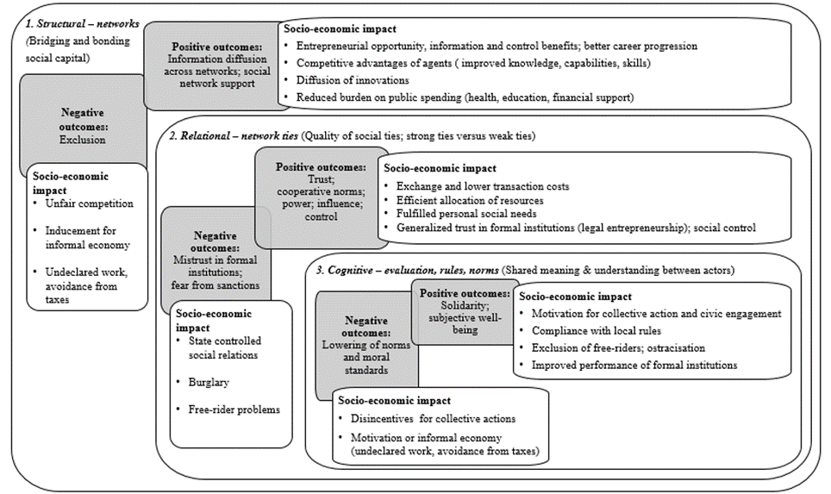

Slide 16
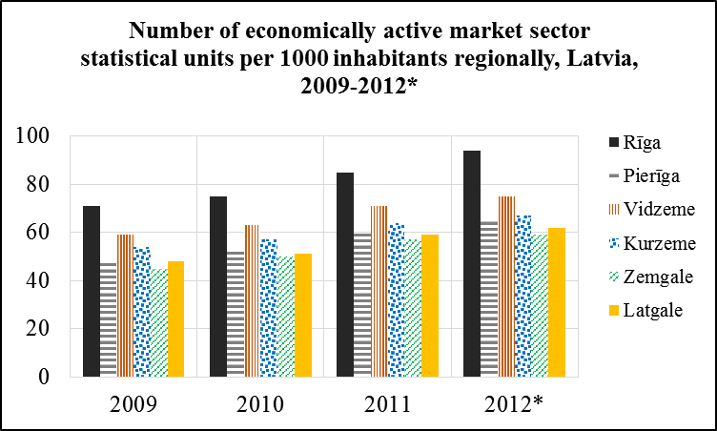

Slide 17
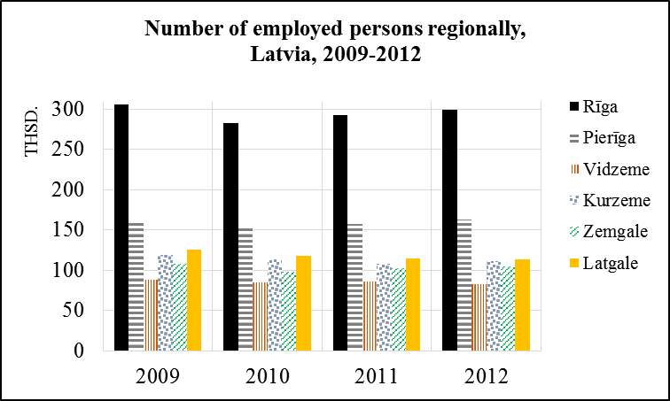

Slide 18
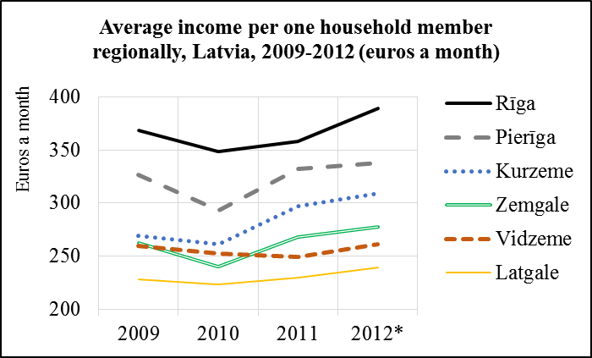

Slide 19
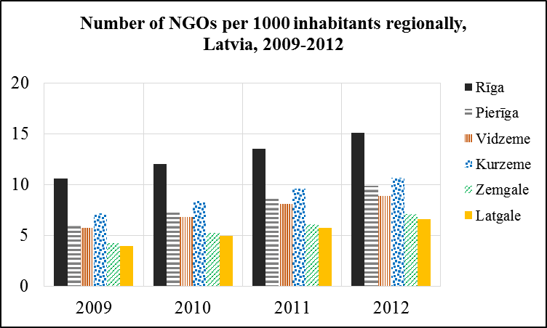

Slide 20
Civic engagement in Latvia – norms do not comply to reaality:
76.7% of respondents in Latvia stated that it is important or very important to vote in elections.
voters turnout in the last parliamentary elections –
60.9% (2006), 63.1% (2010), 59.4% (2011),
and even lower in local elections -
52.8% (2005), 53.8% (2009), 46.0% (2013).
PIRSES-GA-2012-318961

Slide 21
Mistrust in formal institutions:
Only 15.4% agree with the statement: «The present Latvian tax system is fair regarding me and my family»
77 % completey disagree or rather disagree with the sattemet «In general, the collected taxes are correctly allocated in Latvia»
Feeling of inability to influence formal institutions - 29.6% from respondents indicate “rather little” personal ability to influence local government’s decisions of their life, neighborhood, - 58.1% “very little”
PIRSES-GA-2012-318961

